Slide 1
Equations of planes and tangent planes
First recall Chapter 5, Section 5
Equations of Planes

Slide 2
5.5 Planes in Space
♣ A plane Π in space is determined by
a point on the plane &
its orientation (indicated by a normal to Π)
Problem Given point R in plane Π with position
vector & normal
to Π :
find an equation for Π

Slide 3
Vector equation for plane Π
Let P be a point in plane Π with
position vector
r = xi + yj + zk.
Then

Slide 4

5.5.1Cartesian equation for Π

Slide 5
Equations for Π
SUMMARY
♣ Vector equation :
♣ Cartesian equation :
♣ Cartesian equation simplified :

Slide 6
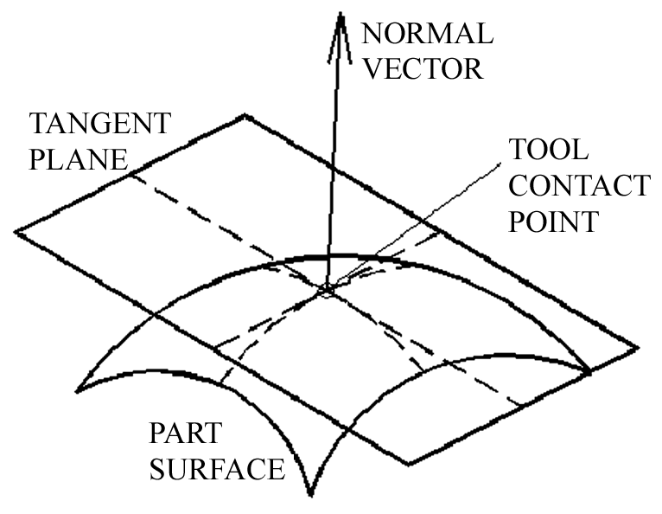
● Tangent Planes
Given : surface S
& a point
Find : the equation
of the tangent plane
to S at

Slide 7
v
curve
curve
u

Slide 8

● Fix . Curve
Tangent vector
● Fix u = . Curve
Tangent vector

Slide 9

● As
provides a normal
vector to the tangent plane. Thus the equation of
the tangent plane is :
See CH5, 5.5 planes in Space

